Slide 1
内容生成技术在大型网络游戏《命运之翼》中的应用
Content Generation Utilization in MMO Title “Wings of Fate”

Slide 2
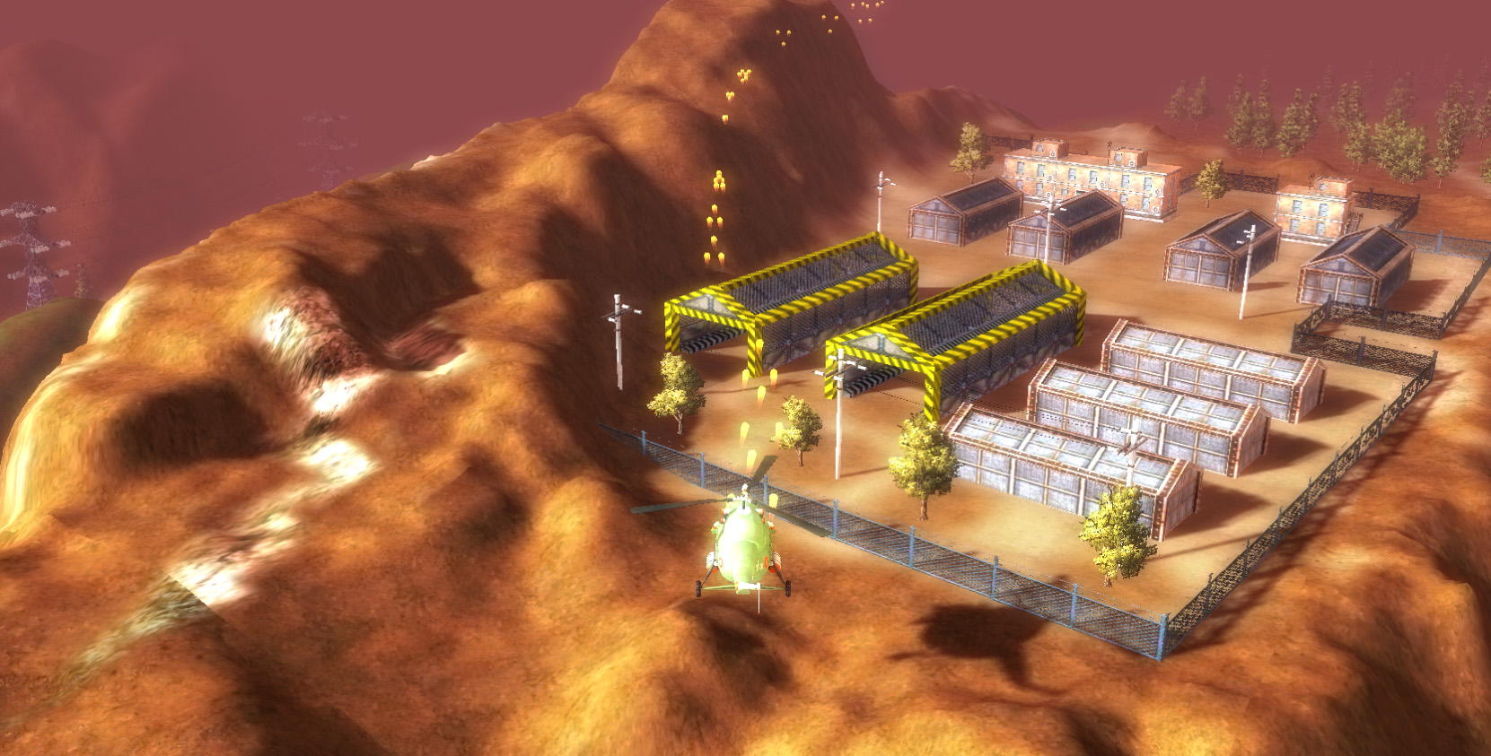
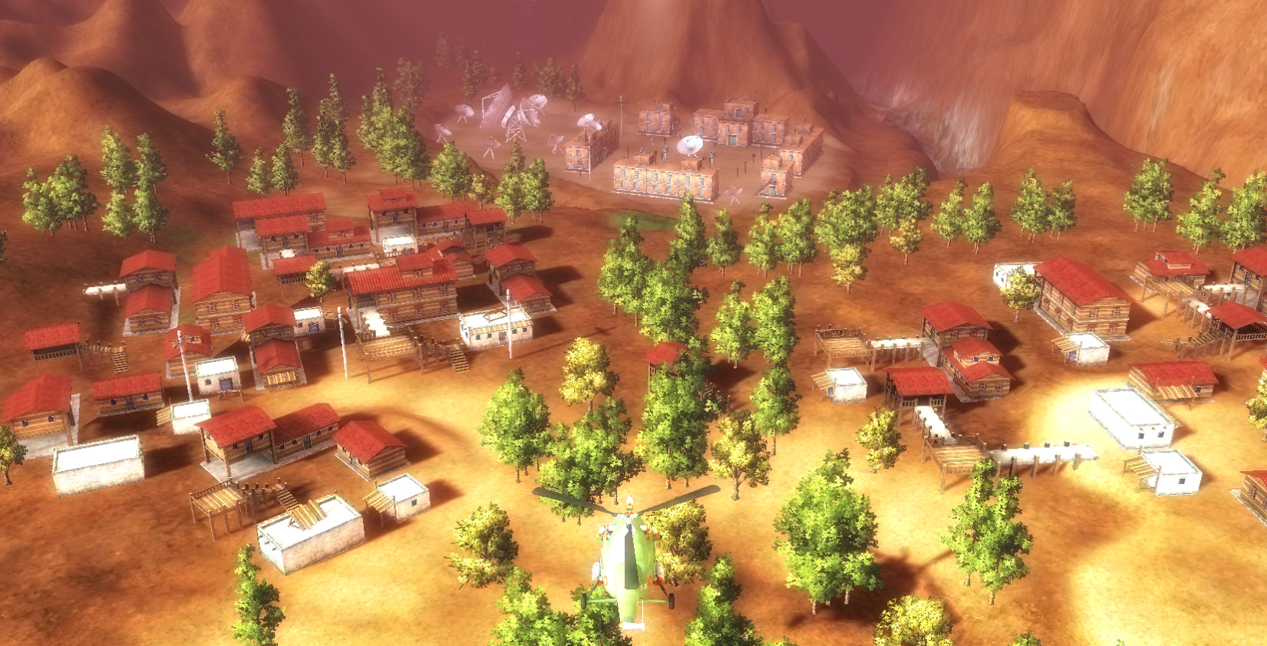
“Wings of Fate” from Entire Games
MMO 科幻射击类游戏
MMO Science-Fiction
Shooting Game
Entire Editor 游戏内容集成工具
Entire Editor - Sophisticated
Game Content Integration Tool
技术集成
Technology Integrations
UrbanPAD
Substance
Gamebryo
PhysX/Bullet
Speedtree

Slide 3
Motivation (Traditional Style)
Core Artist Team
Content Driven
Creation
Management
Which cost heavy workload

Slide 4
Motivation (Modern Style)
Design Driven
Layout
Balance
FX
Which are high-level and creative
Core Artist Team
Content Driven
Creation
Management
Which cost heavy workload
Tools & Machines

Slide 5
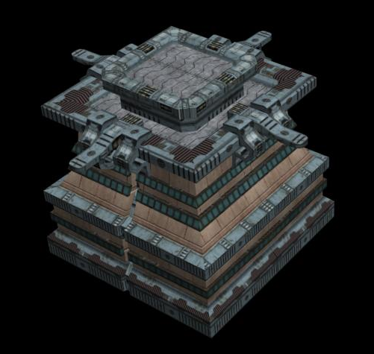
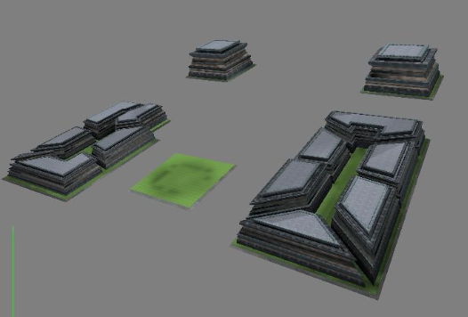
Screenshots for contrast
Before utilizing the Urban Tech, we create variations of objects manually & repeatedly.
Now we create the concept element, with all variations generated out-of-the-box.

Slide 6
优势（Benefits）
节省资源 （Resource-Saving）
包括时间和工作量 （Including time & work）
快速迭代（Faster Iteration）
从沙盒到产品原型（From Sandbox to Prototype）
额外的灵活性（Extra Flexibility）
布局的快速调整（Layout Change）
美术风格的调整（ Style Change）

Slide 7
Pipeline & Architecture
Massive Content Generation
UrbanPAD
Substance
Speedtree
Entire Framework
Gamebryo
Physx/Bullet
Scene Graph
Renderer
Collision

Slide 8
Data Pipeline (Current)
Generation & Processing
MAX
Game
UrbanPAD
Collada

Slide 9
Data Pipeline (Expected)
Generation & Processing
MAX
Game
UrbanPAD
Collada
Built-In Functionality
Entire Editor

Slide 10
结论（Conclusion）
团队创造价值，其他的交给机器
（ People create value, machines do the rest. ）
小型团队同样能制作大型游戏
（ Small teams can create big games.）
潜力仍有待挖掘（Potential value still needs to be digged out.）
更方便的数据交换（Easier Data Exchange）
更好的互操作性（Better Interoperatability）
编辑器内容生成（Built-in procedural content generation in Editor）
游戏内由玩家生成的独一无二的内容（Even in game）

Slide 11
Future - Beyond the tech
更高级的抽象使我们可以控制更高的复杂度，从而带来更丰富的细节
(Higher abstraction makes much more details and complexities manageable)
模式和库（强调复用性）
Patterns & Libraries (Emphasize Reusability)
无序和有序的统一（随机性的粒度控制）
Chaos & Order (Granularity Control of Randomness)

Slide 12
Thank you
谢谢
Entire Games
Gu Lu
gl _at_ entiregames.com

